Slide 1
Genome-wide Analysis of Groucho Function in Drosophila Embryogenesis
Michael Chambers

Slide 2
Gene regulation through concerted action of activators and repressors
On
Co-R
On
Off
A
R
A
Co-A
On
F
F
Co-R
Off
F

Slide 3
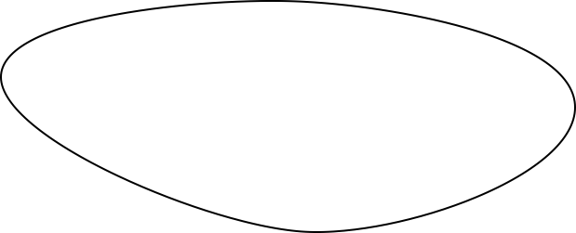
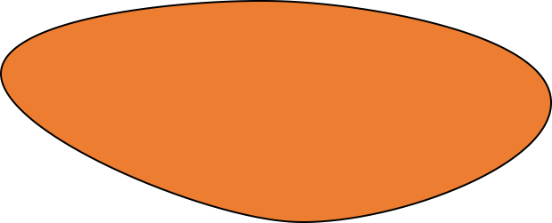
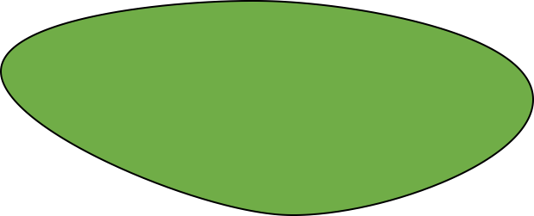
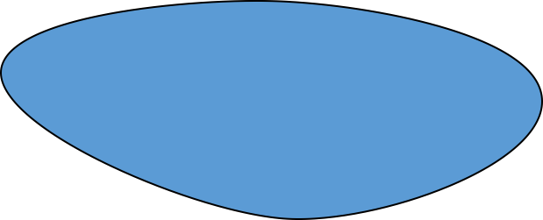
Spatial and temporal regulation of gene expression in development
On
A
Off
R

Slide 4
Morphogen gradients designate cell fate in embryogenesis
Low
Dorsal ectoderm
Embryo
Embryo
Cross-Section
Nuclear Dorsal
Neuroectoderm
High
Mesoderm

Slide 5
Groucho is a co-repressor integral to Drosophila development

Slide 6
Groucho is recruited by multiple sequence-specific factors
Dorsal-ventral patterning
Dorsal
Brinker
Ind
Vnd
Anterior-posterior patterning
Segmentation
Hairy
Runt
Even-skipped
Odd-skipped
Sloppy-paired 1
Engrailed
Knirps
Goosecoid
Terminal patterning
Capicua
Huckebein
Notch signaling
Su(H) E(spl)

Slide 7
Multiple potential mechanisms of Gro-mediated repression
Seikya and Zaret, 2007
Zhang and Emmons, 2002
Cai et al, 2003
Figures Turki-Judeh and Courey, 2012

Slide 8
Outline
A genome-wide survey of Groucho in the early embryo
Identifying components of the Groucho gene regulatory network
Groucho regulation and RNA PolII stalling

Slide 9
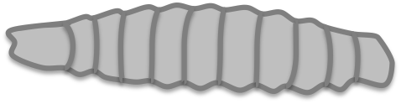

Genomic scale analysis of Groucho’s functions in early fly development
Embryo
24 hr
Larva
4 days
Pupae
5 days
Adult
RNA-seq
Nascent-seq
ChIP-seq
mRNA accumulation
pre-mRNA profiling
Groucho binding
Notes:
nascent-seq: Distribution of ternary elongation complexes
----- Meeting Notes (5/30/13 12:52) -----
Genome-wide instead of genomic scale
24 hr embryogenesis
Pupal 5 days ?
Histone marks under chip-seq

Slide 10
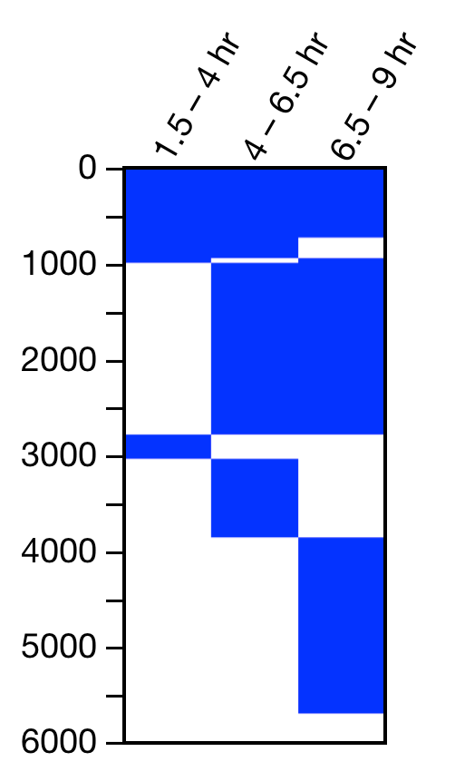
Groucho is recruited to thousands of sites throughout the genome
4 – 6.5 hr
3056
1.5 – 4 hr
6.5 – 9 hr
64
1409
782
717
2311
Gro Binding Sites
Notes:
revise venn or use novel image

Slide 11
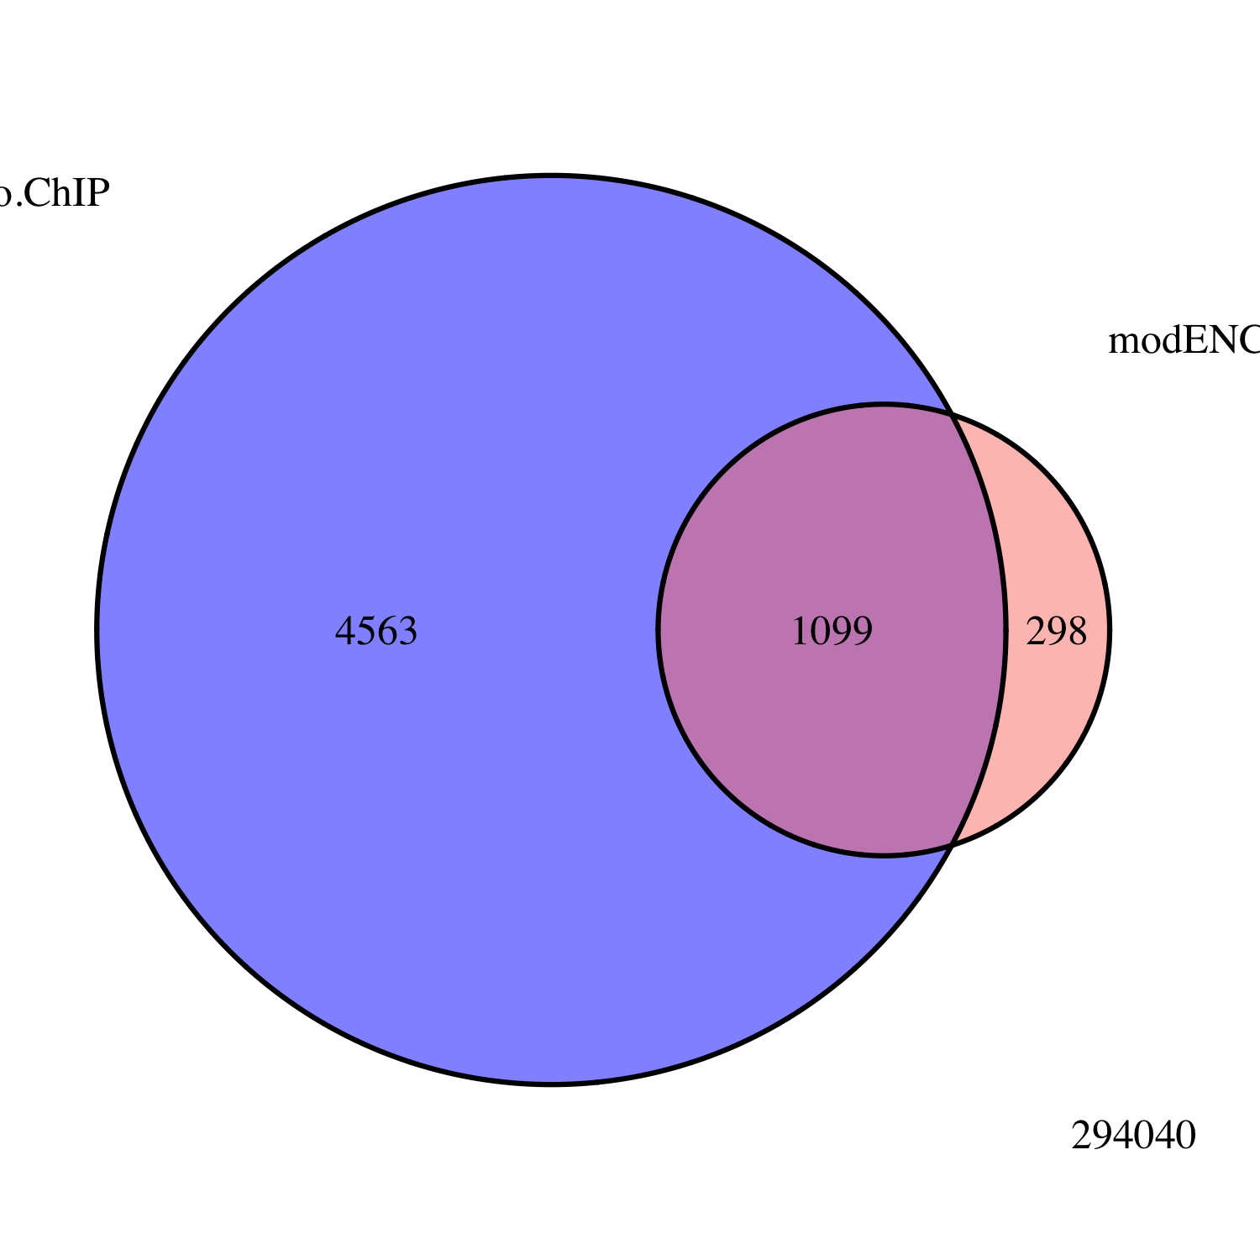
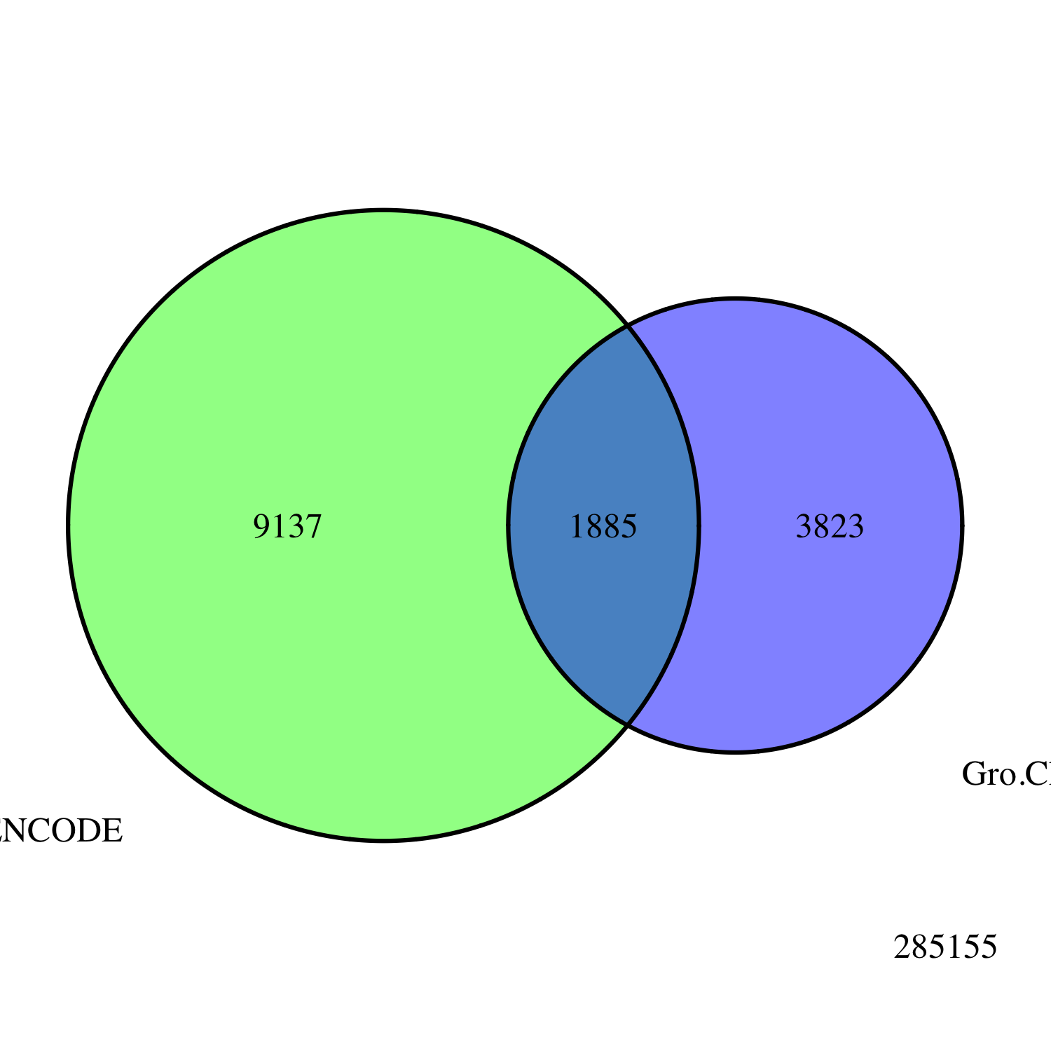
Embryo
Gro ChIP-seq
All Peaks
modENCODE
Embryo
Gro ChIP-chip
Embryo
Gro ChIP
All Peaks
modENCODE
White Pre-Pupae
Gro ChIP-chip
3823
1885
9137
Notes:
Title chip-seq validation

Slide 12
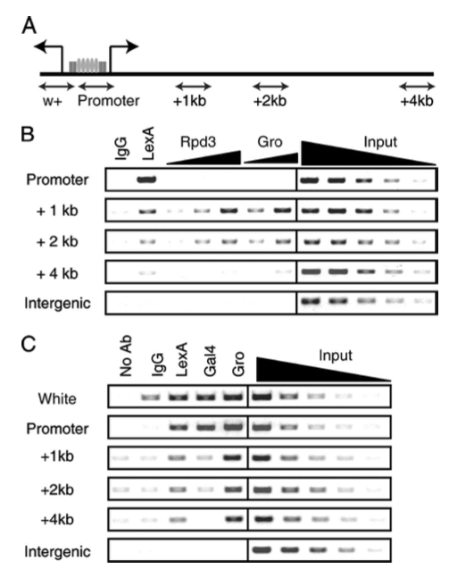
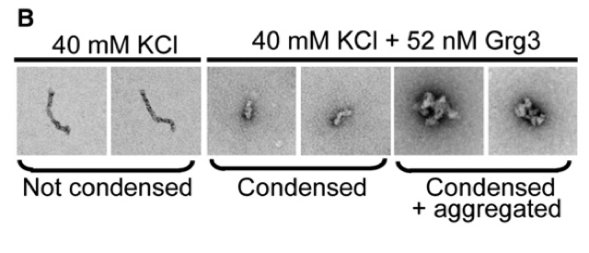
Is Gro spreading a mechanism of long-range repression?
Gro and Rpd3 were found 4kb upstream from a Hairy recruitment site
Gro tetramerizes in vitro via Q-domain interactions
Gro oligomerization necessary for some, but not all, repression in vivo
Q-domain interactions are necessary for chromatin aggregation but not condensation in vitro
Martinez and Arnosti, 2008
Sekiya and Zaret, 2008

Slide 13
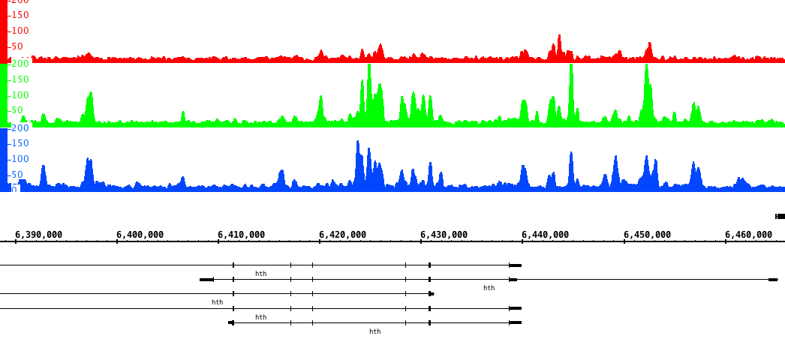
Gro binds in clusters of discrete peaks
1.5 – 4 hr
4 – 6.5 hr
6.5 – 9 hr
hth

Slide 14
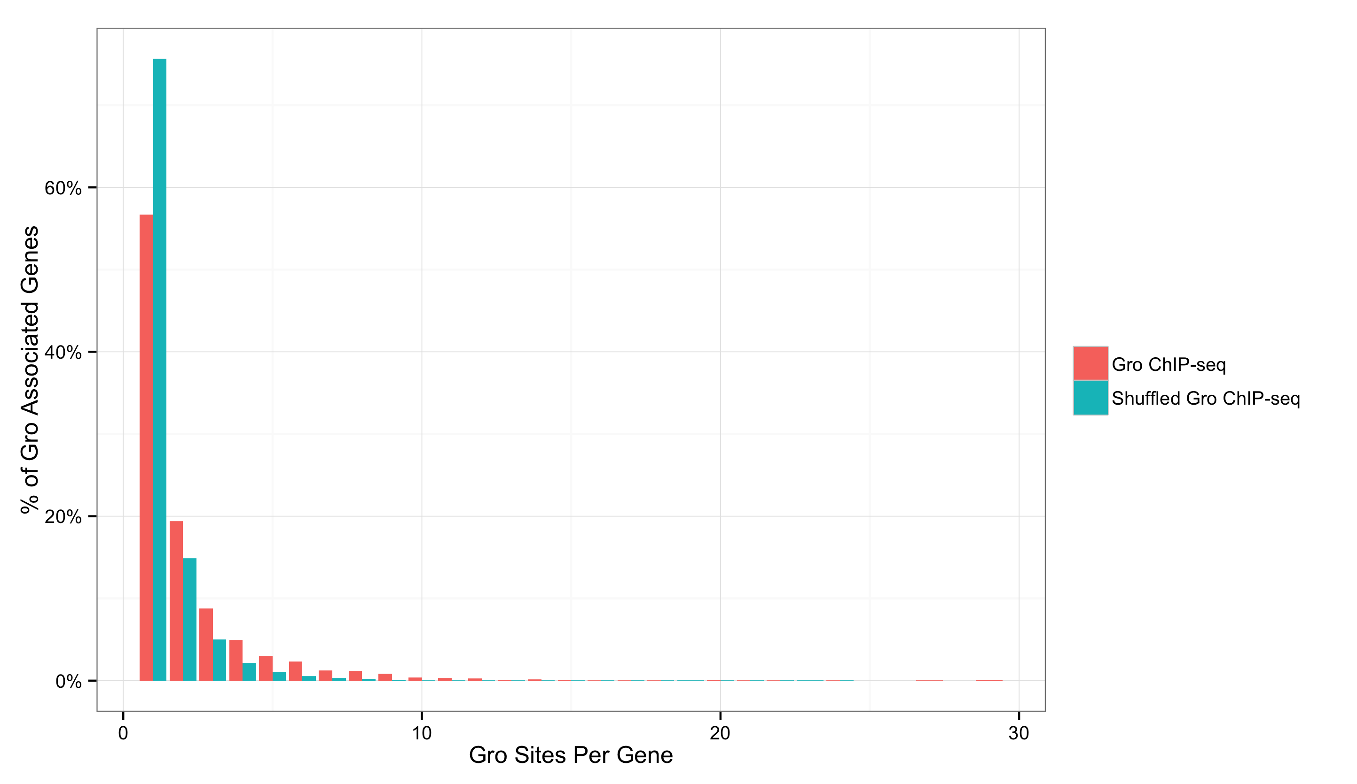
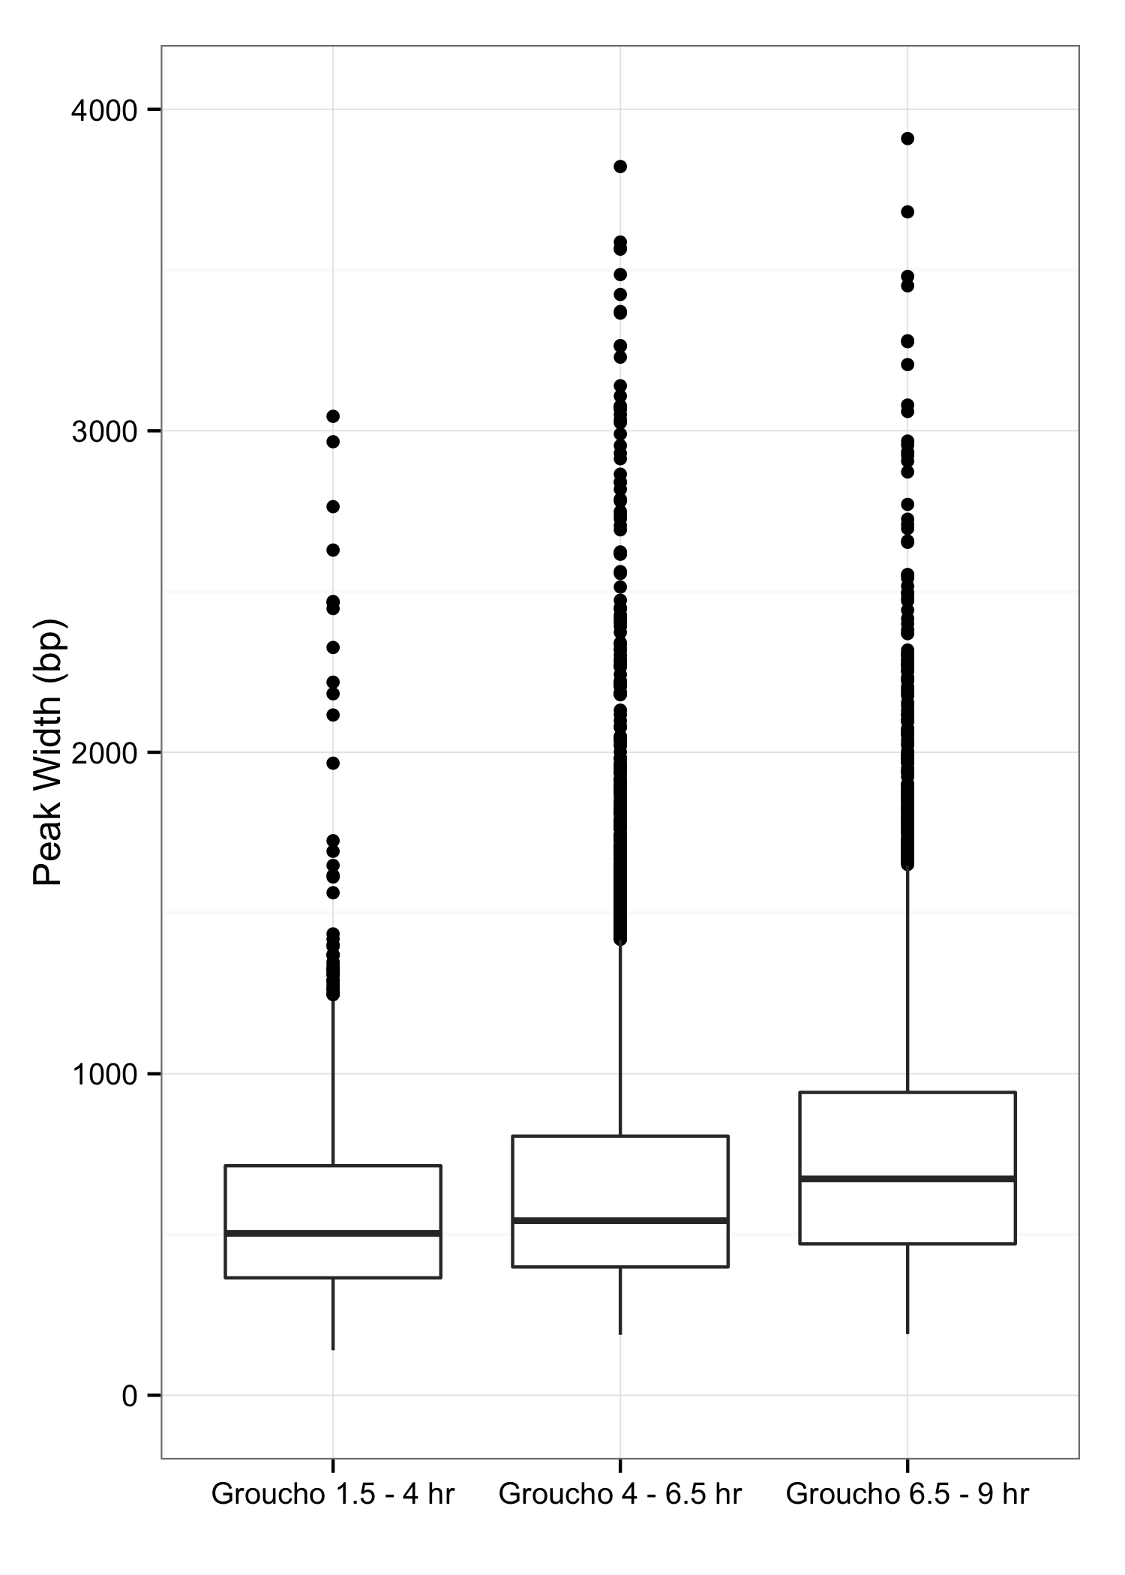
Gro binding is not indicative of spreading in vivo
1
2
3
4
5
Notes:
y-axis
Zaret lab data

Slide 15
If Gro spreading is rare, how does it participate in long-range repression?

Slide 16
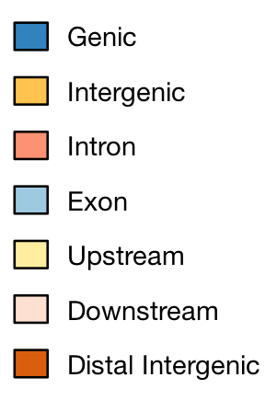
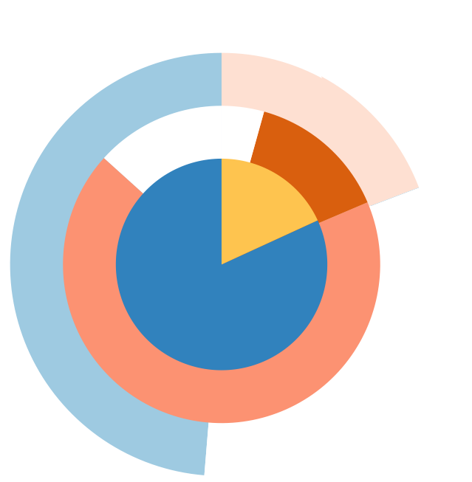
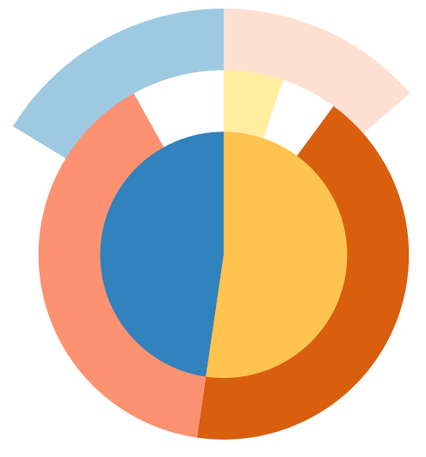
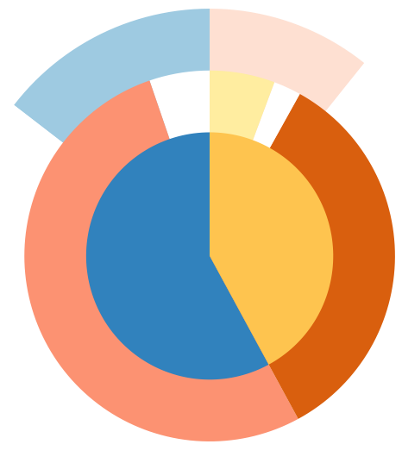
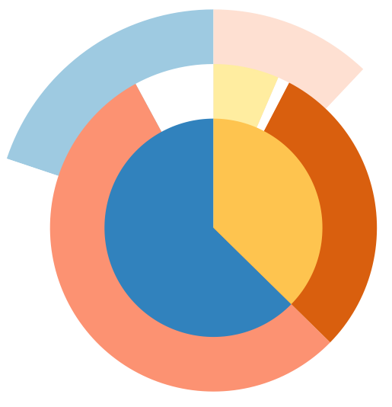
Binding to genes is enriched for multiple peak clusters
dCTBP
1.5 – 4 hr
4 – 6.5 hr
6.5 – 9 hr
Groucho
Notes:
Spreading vs looping

Slide 17
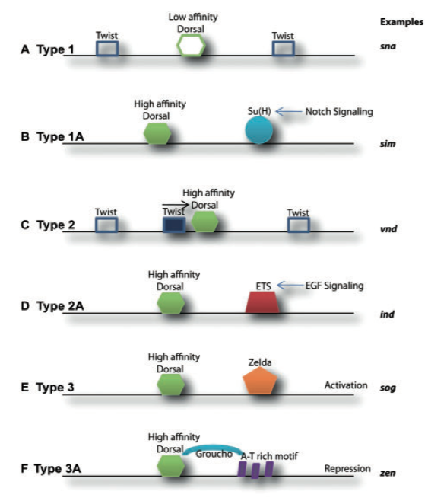
What is the nature of Dorsal dependence on Gro for repression?
Type 3
(dorsal ectoderm)
Low
Embryo
Embryo
Cross-Section
Type 2
(neuroectoderm)
Nuclear Dorsal
High
Type 1
(mesoderm)
Chopra and Levine, 2009

Slide 18
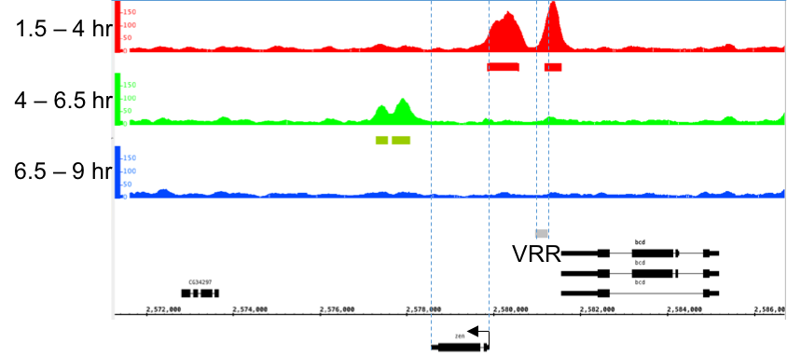
Class 1: zen
zen
bcd

Slide 19
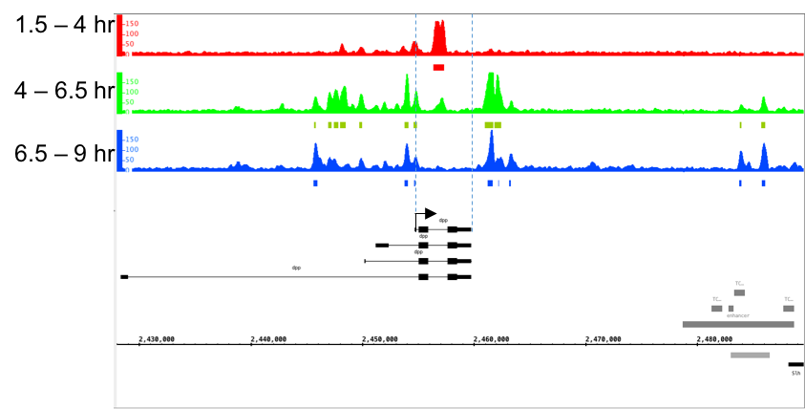
Class 1: dpp
dpp

Slide 20
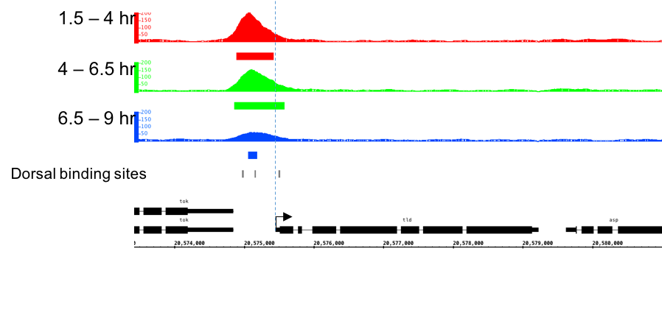
Class 1: tld
tok
tld

Slide 21
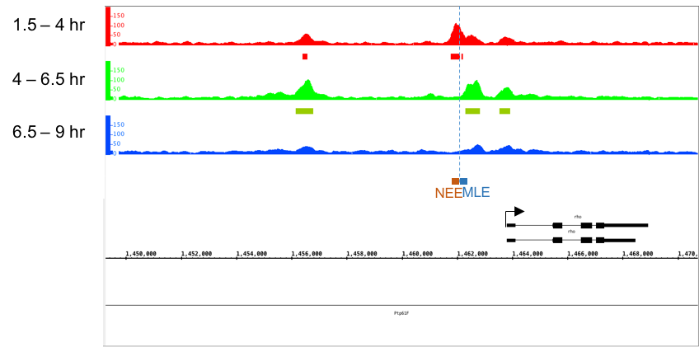
Class 2: rho
rho

Slide 22
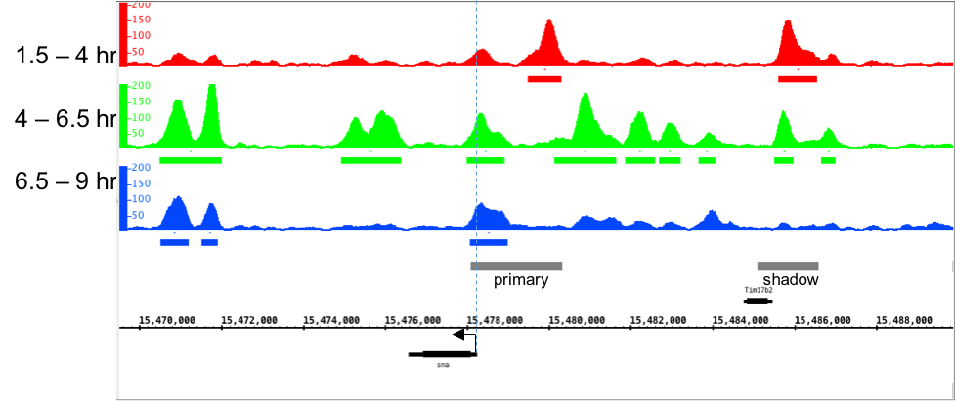
Class 3: sna
sna

Slide 23
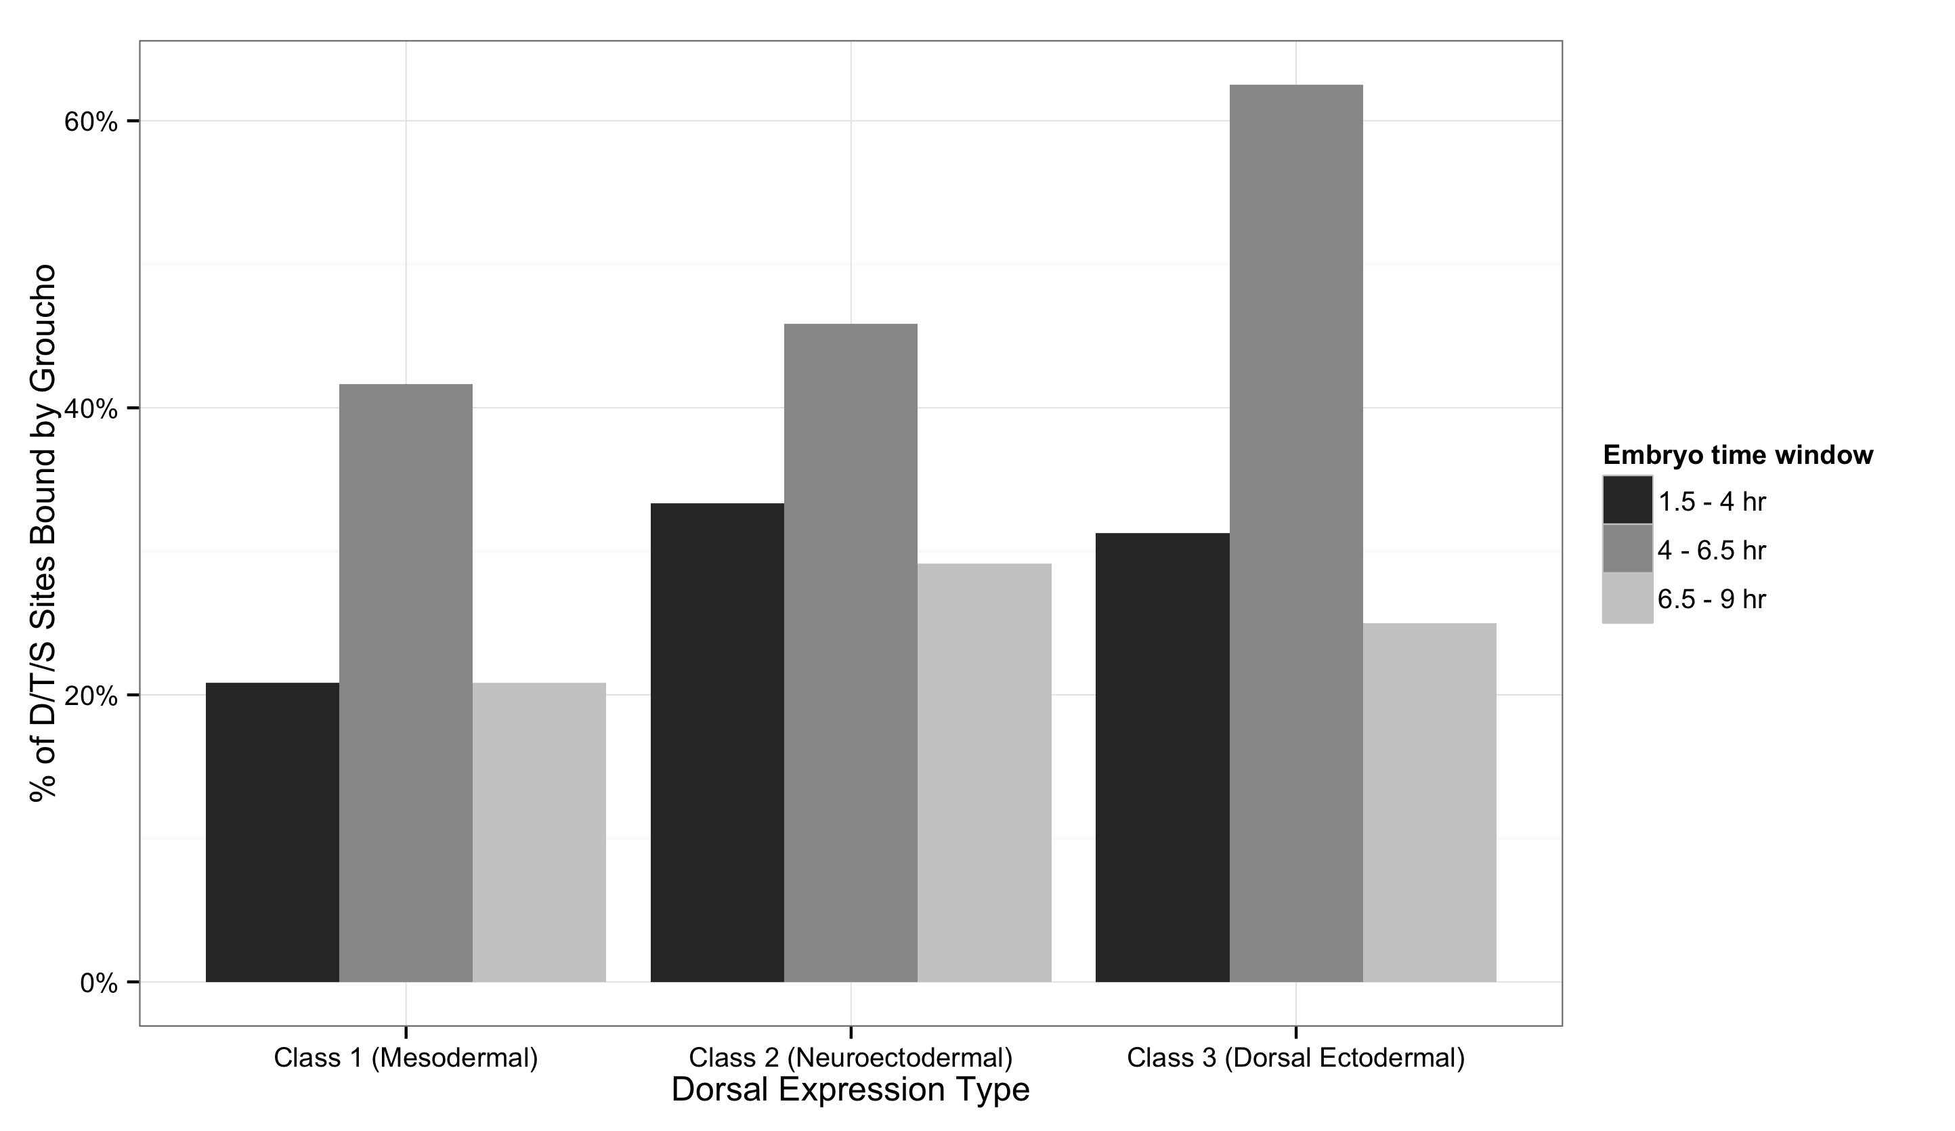
Gro is found at all classes of Dorsal binding site
Notes:
Start with known and snail
I propose that ...

Slide 24
Outline
A genome-wide survey of Groucho in the early embryo
Identifying components of the Groucho gene regulatory network
Groucho regulation and RNA PolII stalling

Slide 25
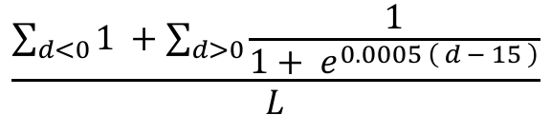
Integrating Gro binding and transcriptome data in embryos
All expressed genes
Calculate “Gro occupancy score”
$$\frac{\sum_{d<0}{1 }+\sum_{d>0}{\frac{1}{1+ e^{0.0005 \left( d − 15 \right)}}}}{L}$$
=
Define occupancy score cutoff from response curve
Gro occupancy score
target genes

Slide 26
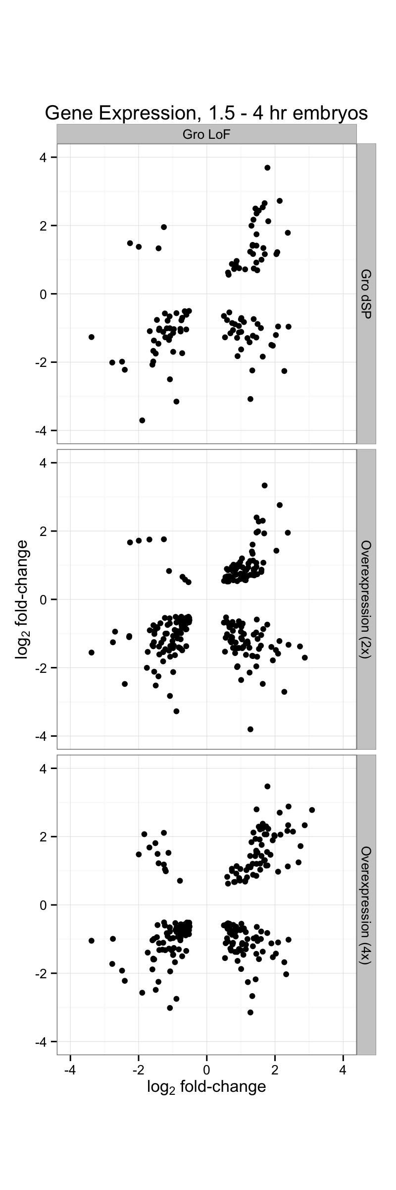
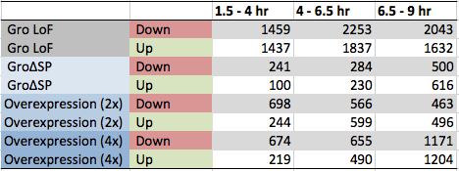
Perturbation of Groucho levels affects thousands of genes

Slide 27
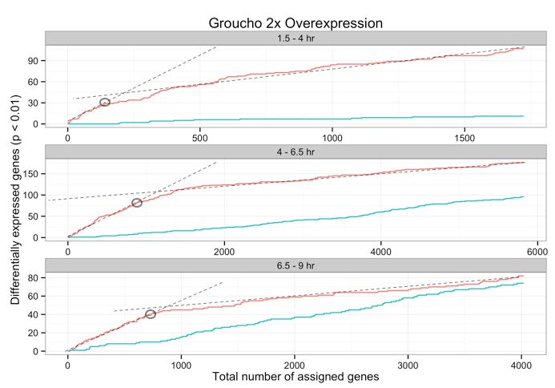
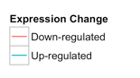
Notes:
Start with Gro gain of function
x-axis: Gro occupancy rank

Slide 28
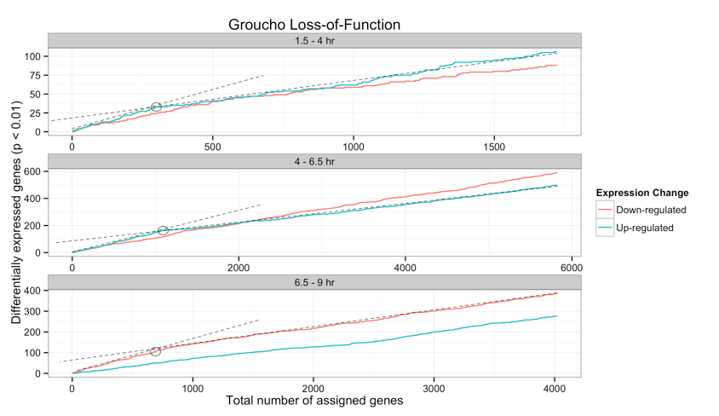

Slide 29
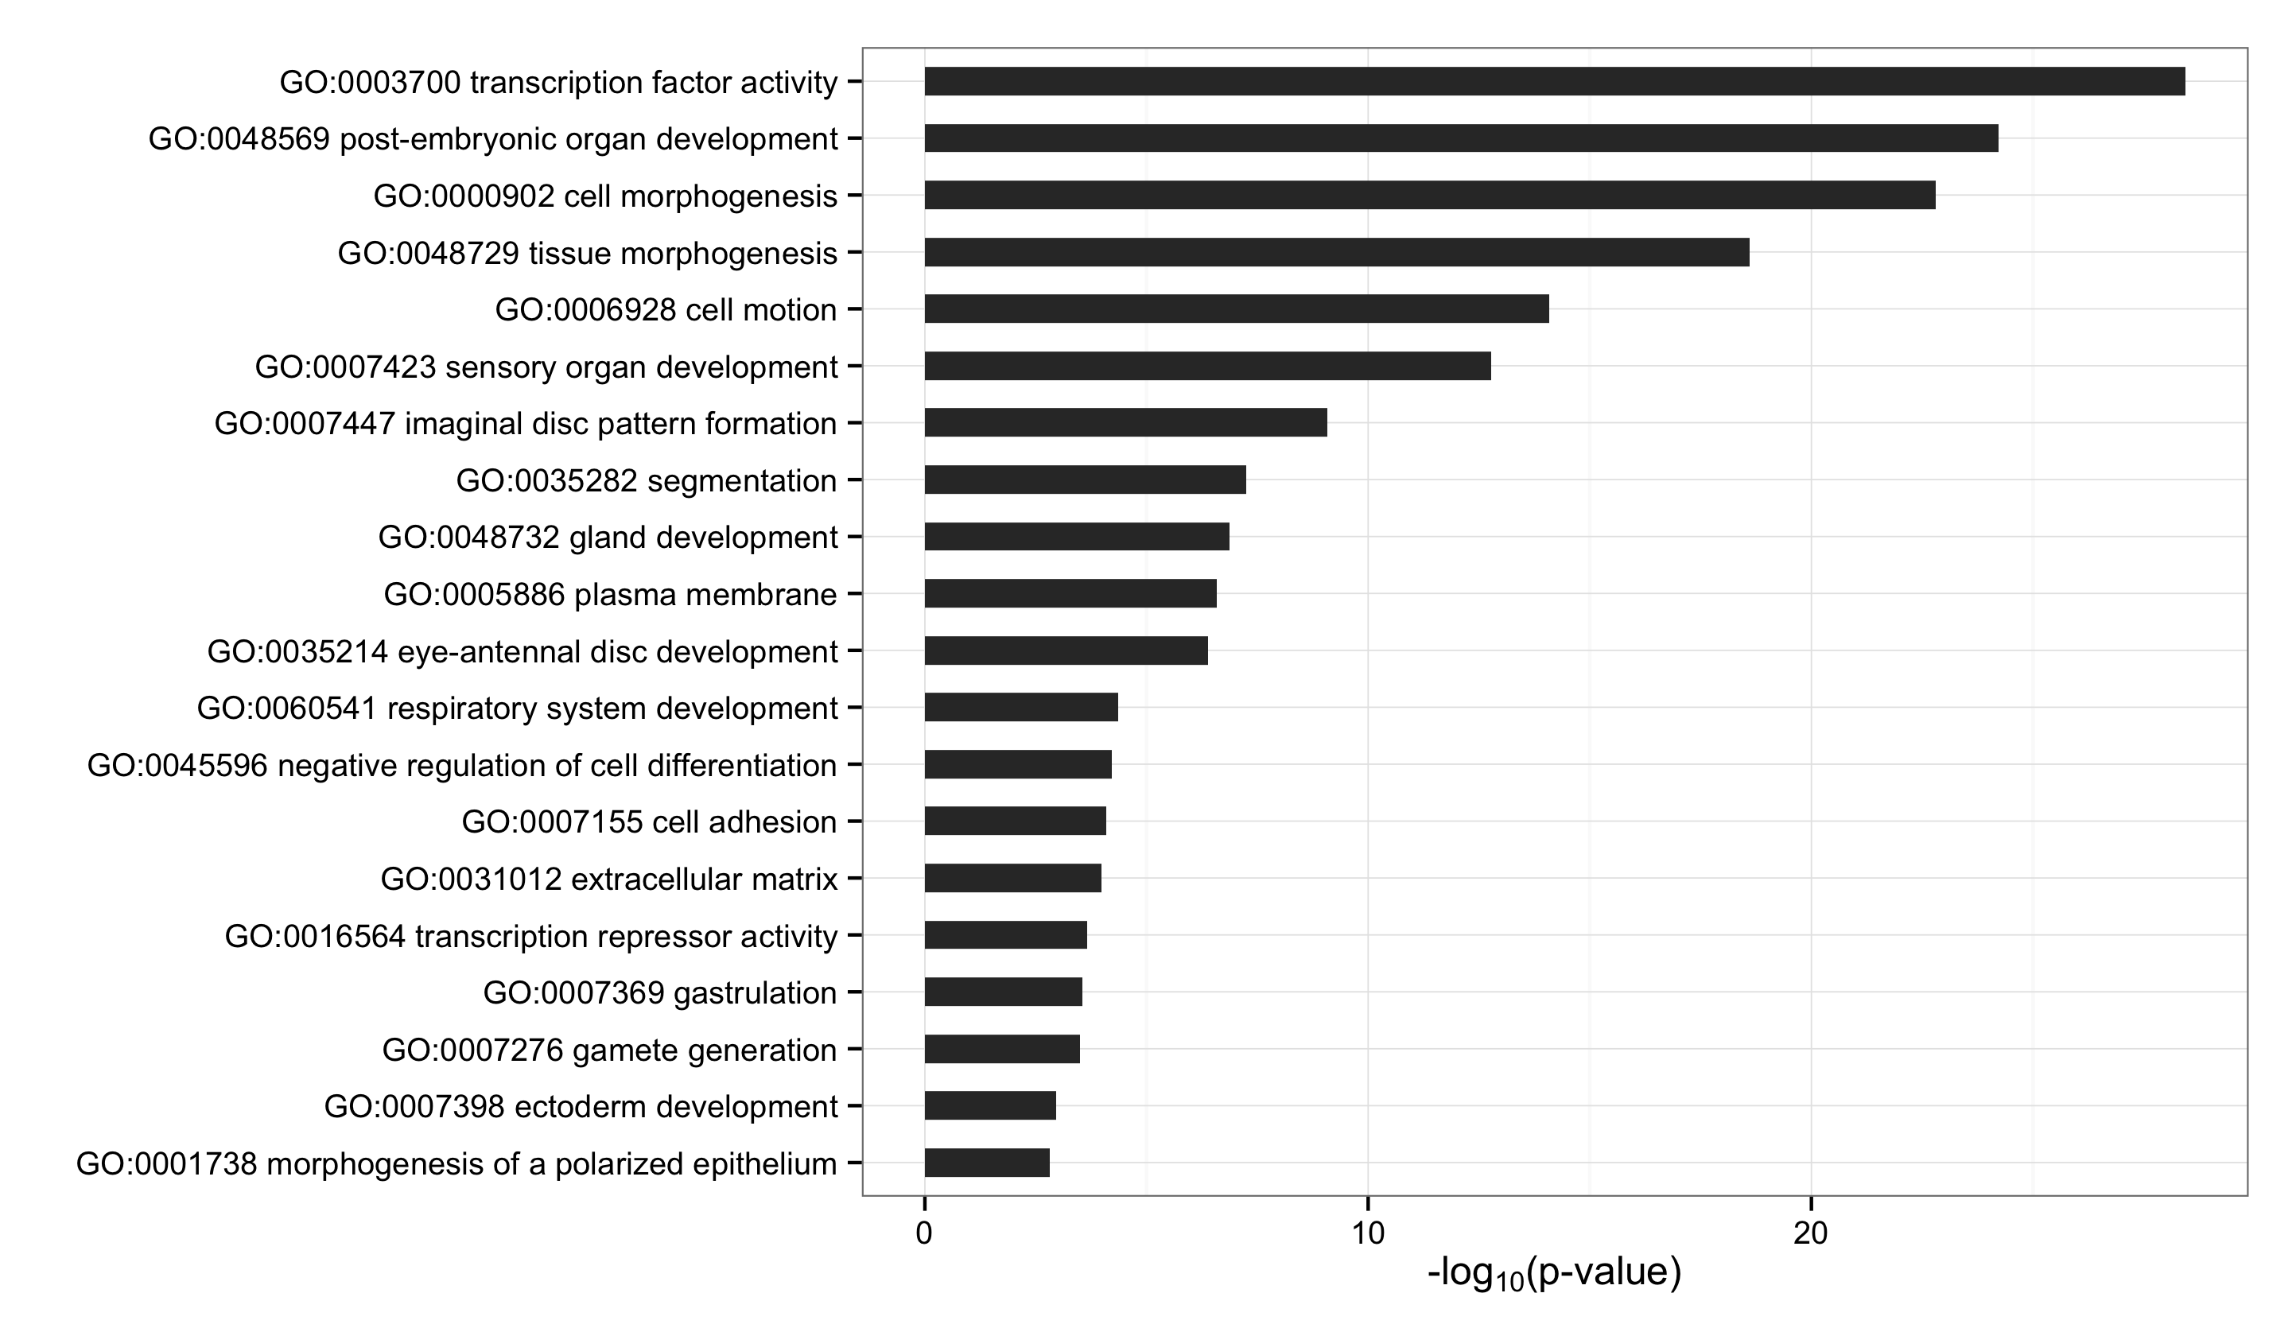
Gro target genes are enriched for developmental TFs
Notes:
Focus on gro occupancy

Slide 30
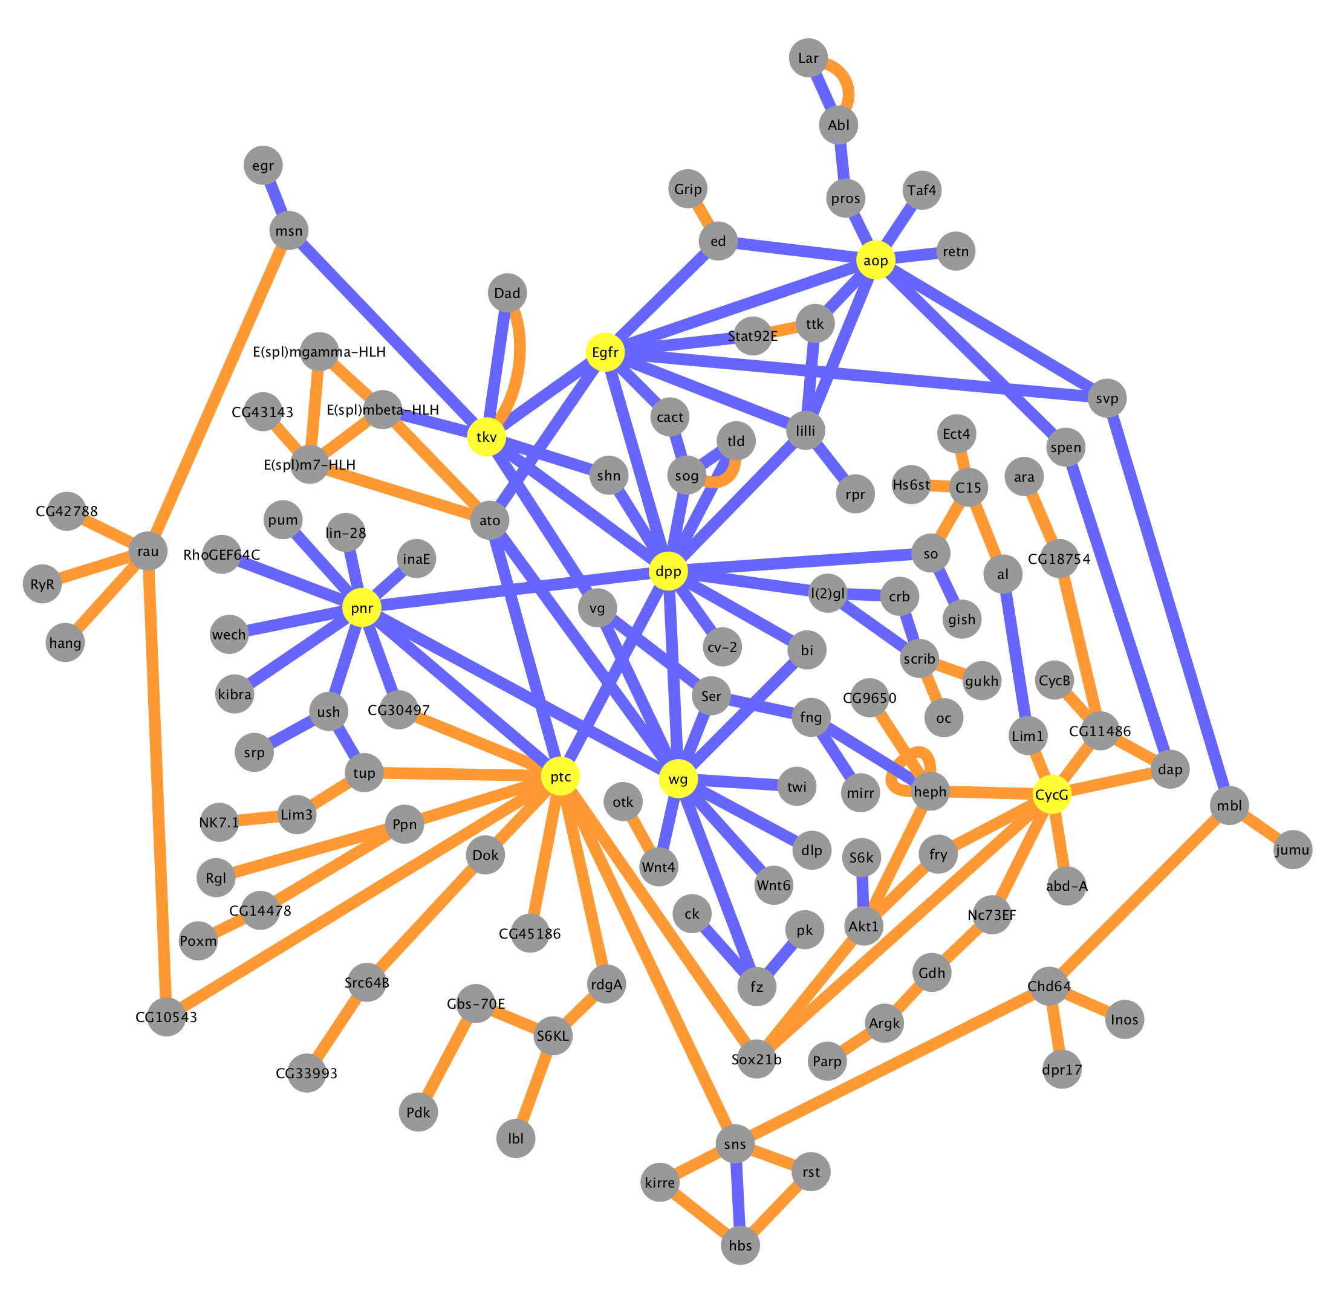
Gro Targets by Occupancy Score
Physical interaction
Genetic interaction
Hubs
Signaling
dpp
wg
Egfr
Transcription factors
pnr
ptc
tkv
aop

Slide 31
Outline
A genome-wide survey of Groucho in the early embryo
Identifying components of the Groucho gene regulatory network
Groucho regulation and RNA PolII stalling

Slide 32
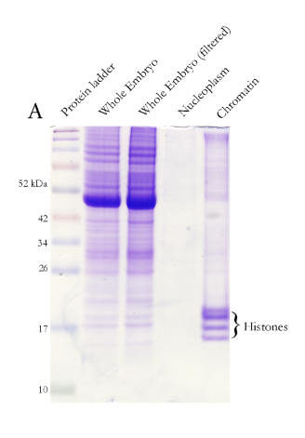
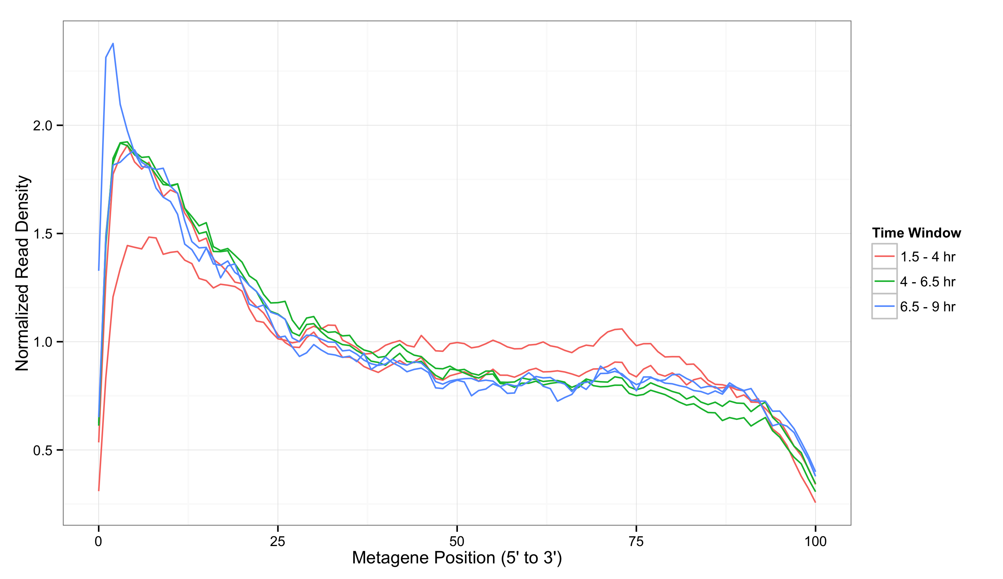
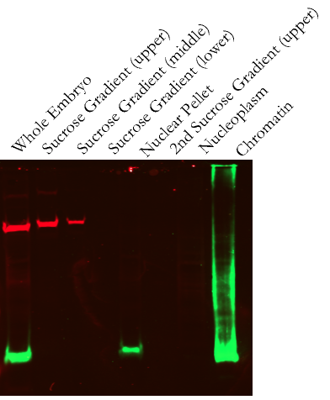
Isolation of nascent pre-mRNA
α-tubulin
α-H3
Notes:
Set-up PolII stalling

Slide 33
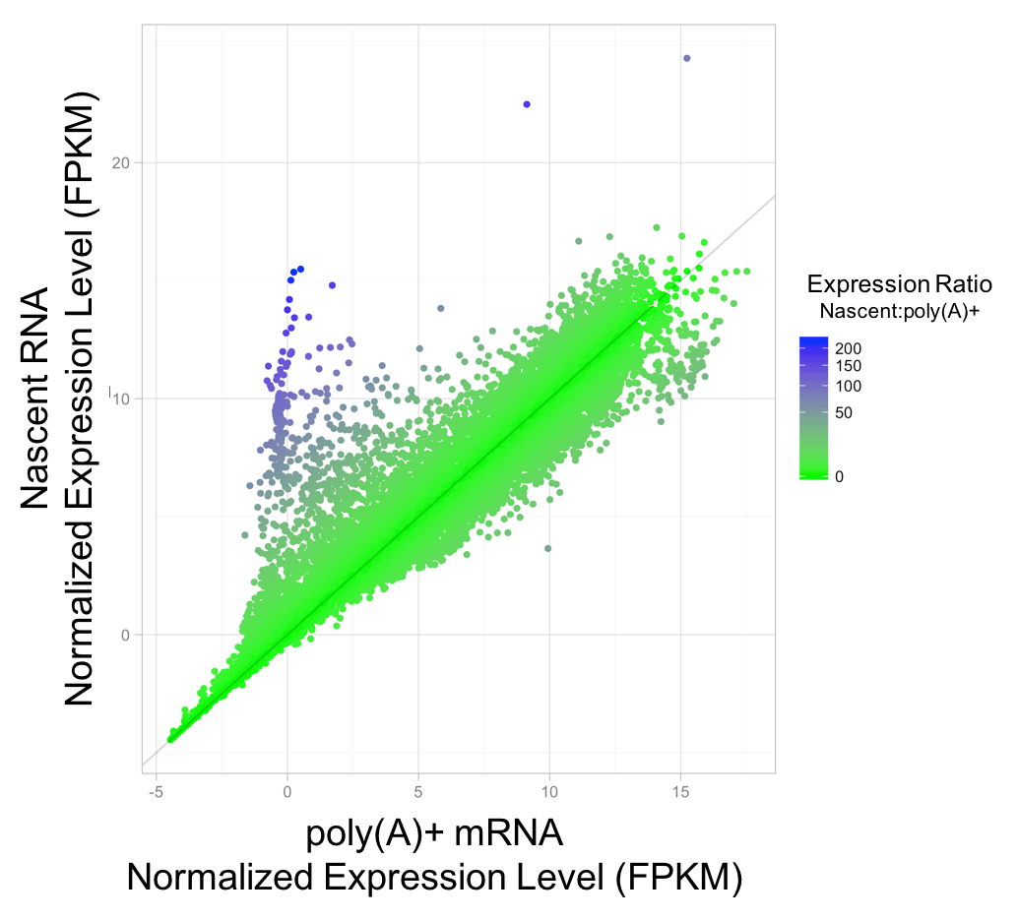
Different relative transcript abundance in nascent versus total RNA

Slide 34
Nascent-RNA is depleted for maternally contributed transcripts
Notes:
Remove non-polyA points from plot
LImit to maternal

Slide 35
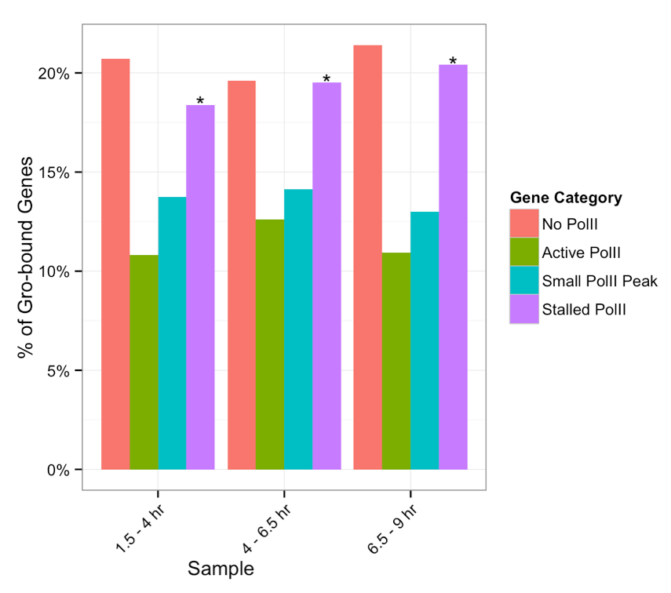
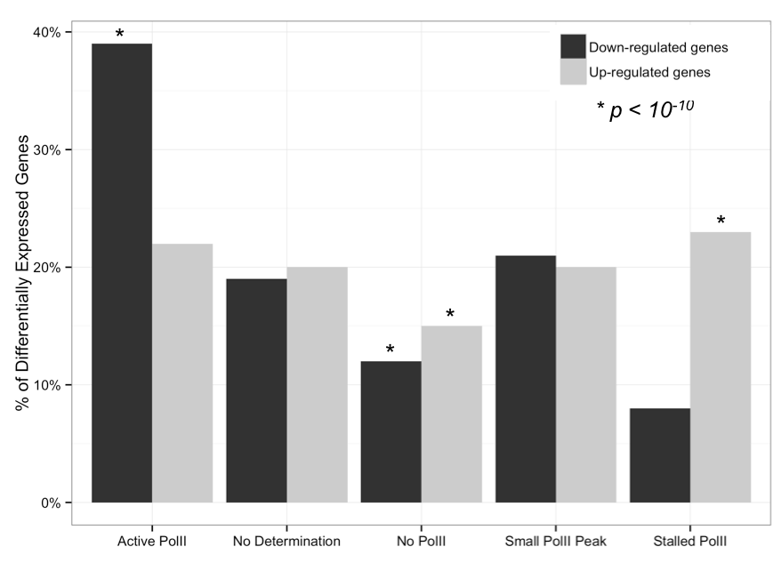
Gro bound and repressed genes are enriched for stalled PolII

Slide 36
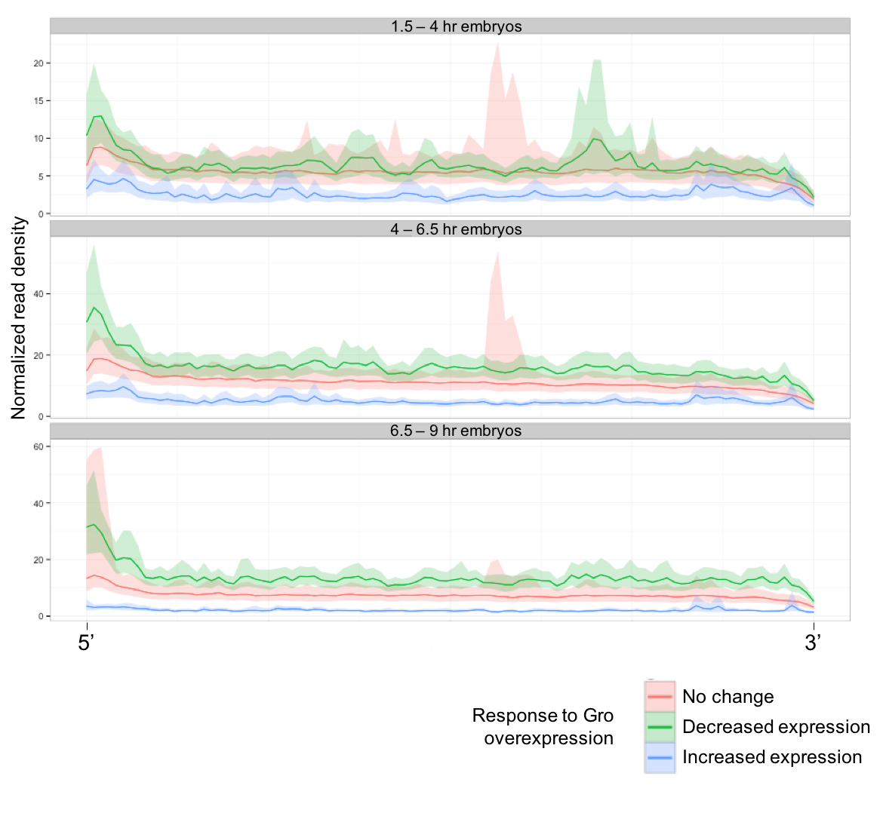
Gro-repressed genes are enriched for 5’ read density
Notes:
Remove shading

Slide 37
Conclusion
Gro binding is inconsistent with a spreading model of long-range repression
Gro may be recruited or loop directly into promoter-proximal regions to establish repression
Gro regulates the inputs and outputs of multiple signaling pathways
Gro-repressed genes are enriched for poised PolII
May represent priming for rapid/synchronous activation

Slide 38
Acknowledgements
Courey Lab
Albert Courey
Joseph Cao
Kenny Chen
Mitchell Kim
Pak Kwong
Wiam Turki-Judeh
Tom Yau
Committee
Dr. James Bowie
Dr. Michael Carey
Dr. Catherine Clarke
Dr. Volker Hartenstein
Collaborators
Sean Gallaher (Merchant Lab)
Kelvin Zhang (Zipursky Lab)

